Slide 1
Adaptive sampling of ocean fronts with multiple AUVs
Trial lecture
Ph.D. Candidate: Yaolin Ge
Date of the trial lecture: 2024-05-08
Department of Mathematical Sciences
Faculty of Information Technology and Electrical Engineering

Slide 2
Agenda
Ocean fronts
Autonomous Underwater Vehicles (AUVs)
Adaptive sampling
Case studies
Remarks
Conclusion

Slide 3
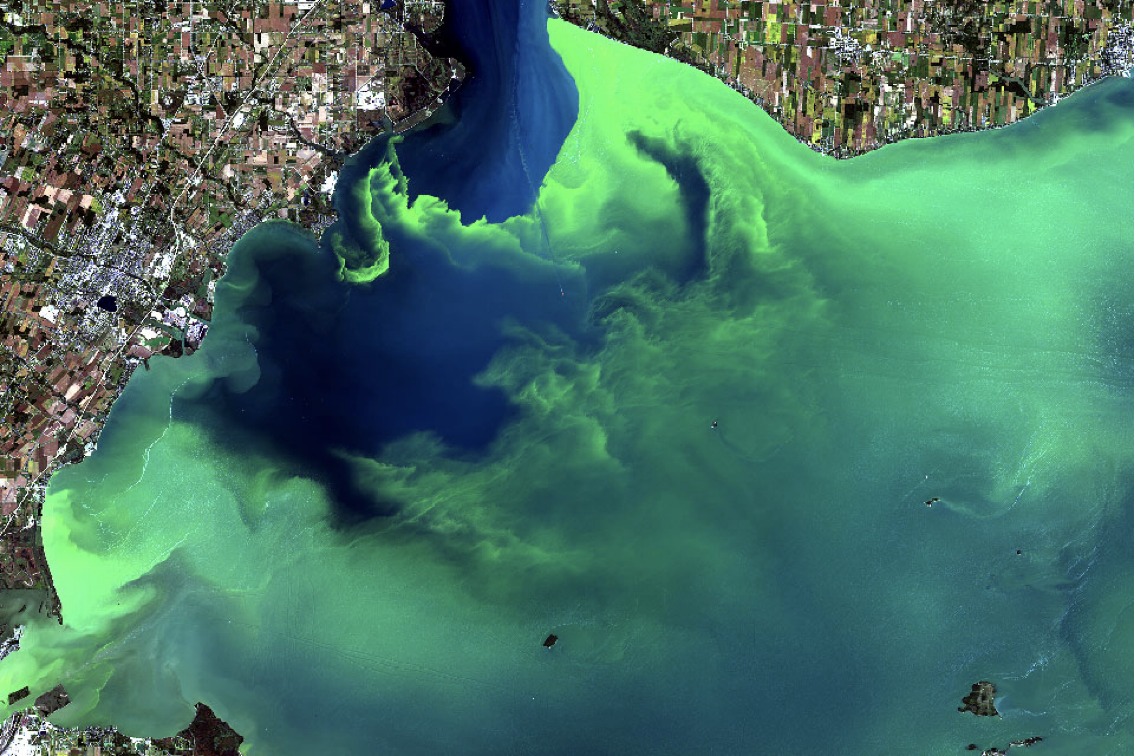
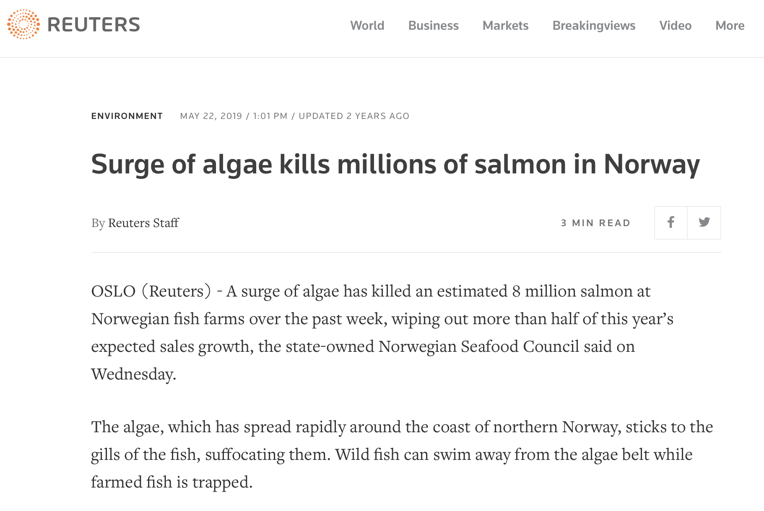
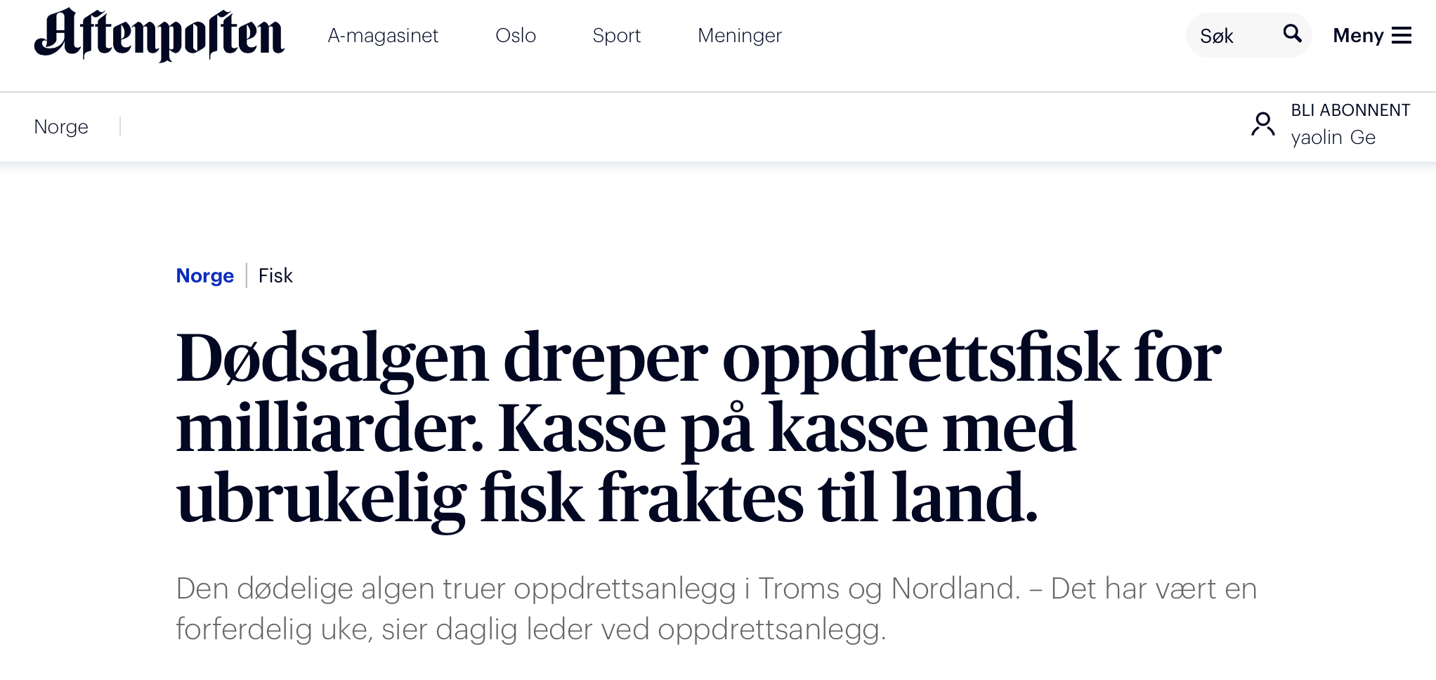
Ocean fronts
What is oceanfront?
Why is it important in the ecosystem and climate?
Notes:
Ocean fronts are boundaries between two distinct water masses in the ocean, characterized by differences in temperature, salinity, and density.
These fronts are often marked by sharp changes in oceanic properties, leading to the formation of distinct water layers.
Importance of Ocean Fronts:
Climate Regulation:
Ocean fronts influence weather and climate patterns by affecting ocean currents and the distribution of heat across the planet.
Marine Biodiversity:
Fronts are rich in nutrients, making them vital areas for marine life. They support diverse ecosystems, including many fish species, which thrive on the abundant food supply.
Ocean Circulation:
They play a crucial role in the global ocean circulation system, which helps in the distribution of heat, nutrients, and gases across the oceans.
Commercial Significance:
Fronts are key fishing zones due to the high productivity and aggregation of marine organisms, supporting local and global fishing industries.
Research and Monitoring:
Studying ocean fronts helps scientists understand more about oceanic processes, aiding in the prediction of weather events and long-term climate changes.

Slide 4
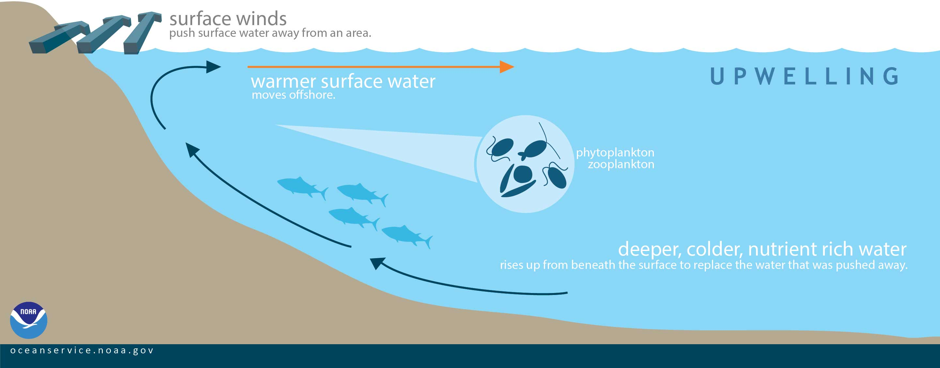
Ocean fronts (upwelling)
Notes:
Upwelling is a process where deep, cold, and nutrient-rich water rises to the surface of the ocean. This phenomenon typically occurs along coastlines and is driven by wind.
Mechanisms of Upwelling:
Winds blowing across the ocean surface push water away. Due to the Coriolis effect, water is replaced by water from below, which is colder and contains higher concentrations of nutrients.
Importance of Upwelling:
Marine Ecosystems:
Upwelling zones are some of the most biologically productive waters in the ocean. The influx of nutrient-rich water supports the growth of phytoplankton, which serves as the base of the marine food web.
Fisheries:
Many of the world’s major fisheries are located in upwelling regions due to the high productivity of these waters. Species such as sardines and anchovies thrive in these conditions, supporting large commercial fisheries.
Climate Impact:
Upwelling regions contribute to global carbon cycles. Phytoplankton in these areas absorb CO2 during photosynthesis, playing a significant role in the sequestration of carbon and impacting global climate.
Biodiversity:
The abundance of nutrients leads to high biodiversity. Upwelling areas support a wide variety of marine species, making them crucial for conservation efforts.
Local Economies:
Coastal communities often depend on upwelling regions for their livelihoods through fishing, tourism, and other marine-related industries.

Slide 5
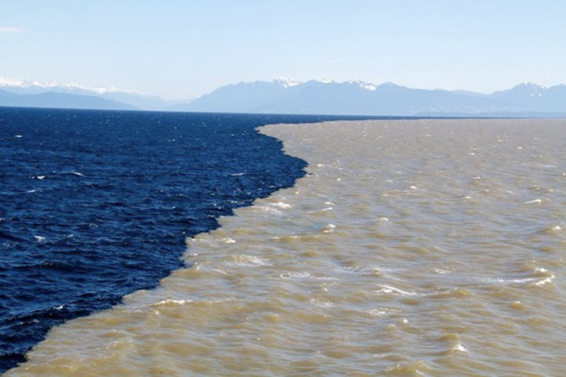
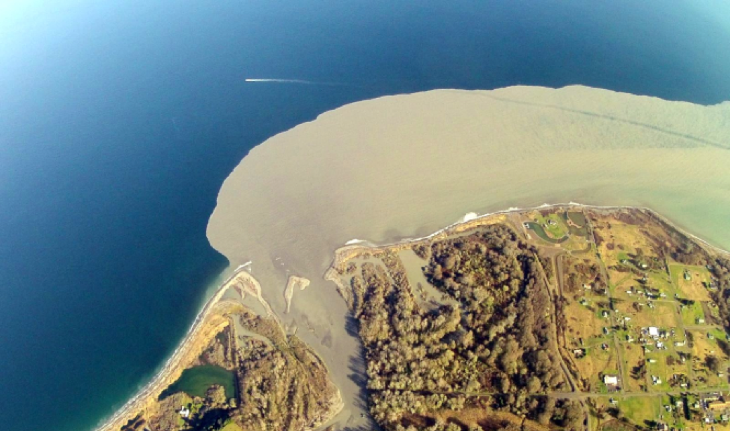
Ocean fronts (surface plume)
Fraiser River, Vancouver, Canada (@PEACE ARCH NEWS)
Elwha River (@University of Washington)
Notes:
A surface plume refers to the area where freshwater from rivers mixes with saltwater in the ocean. This mixing creates a distinct body of water that is different in temperature, salinity, and often in color from the surrounding seawater.
These plumes can spread far into the ocean, depending on river discharge rates, prevailing winds, and ocean currents.

Slide 6
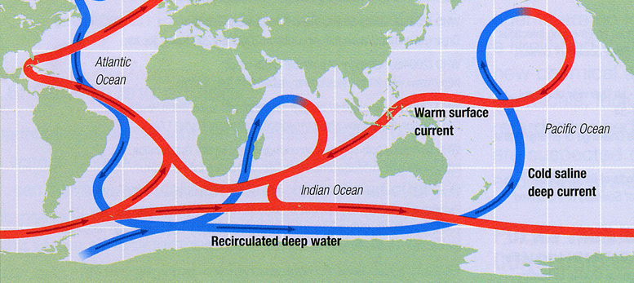
Ocean fronts (thermohaline)
Source: Ginny Brown, National Council for Science and the Environment
Notes:
Thermohaline circulation refers to a part of the large-scale ocean circulation that is driven by global density gradients created by surface heat and freshwater fluxes. The term "thermohaline" combines "thermo" (heat) and "haline" (salt), which together determine the density of sea water.
Mechanism of Thermohaline Circulation:
Water density variations, which are influenced by temperature and salinity, drive this circulation. Cold, salty water is dense and sinks, while warm, less salty water is less dense and rises.
Importance of Thermohaline Circulation:
Global Climate Regulation:
Thermohaline circulation helps distribute heat and energy around the earth’s oceans, influencing global climate and weather patterns.
Nutrient and Gas Exchange:
This circulation promotes the deep ocean mixing, which brings oxygen from the surface to the depths and helps cycle nutrients across marine ecosystems.
Carbon Cycle:
By transporting carbon-rich water from the surface to the deep ocean, thermohaline circulation plays a critical role in the global carbon cycle, affecting atmospheric carbon dioxide levels and global warming.
Impact on Marine Life:
The movement of nutrient-rich water supports marine biodiversity, particularly in deeper ocean layers that rely on surface-derived nutrients.
Influence on Weather Systems:
Changes in thermohaline circulation can influence weather systems, potentially leading to significant climatic changes, such as colder winters in Europe if the North Atlantic circulation weakens.

Slide 7
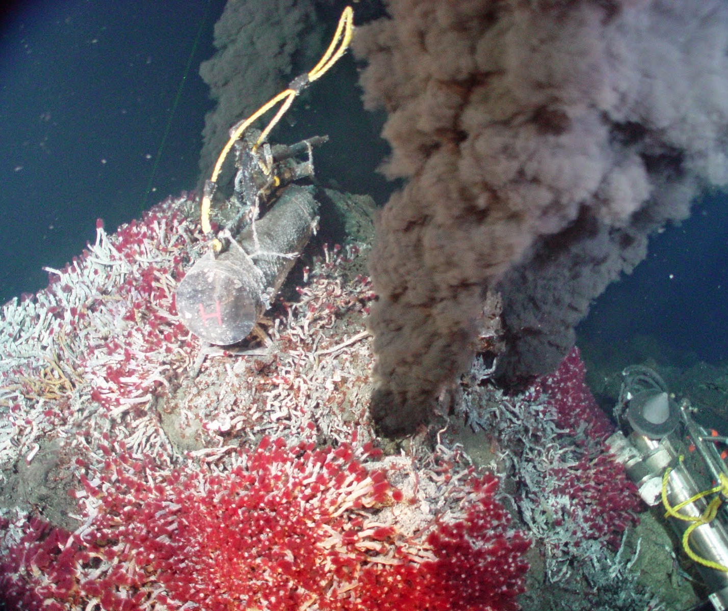
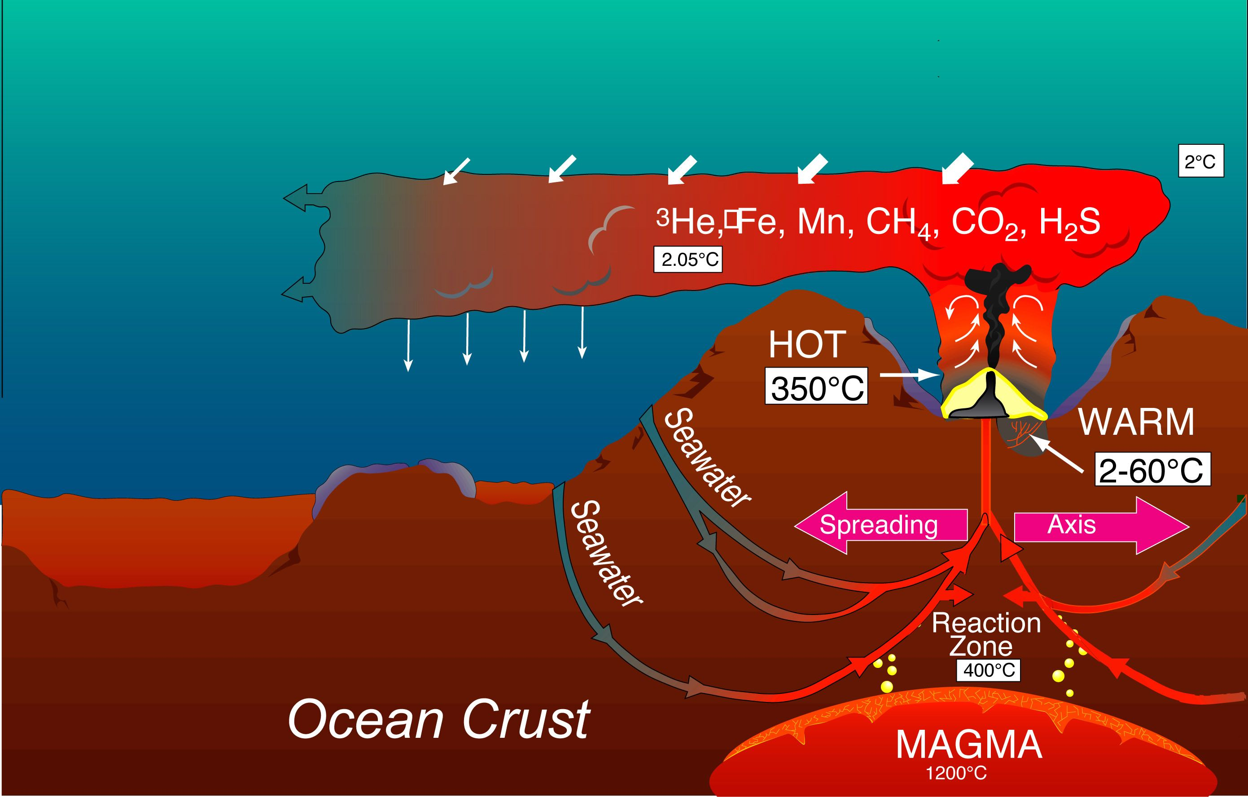
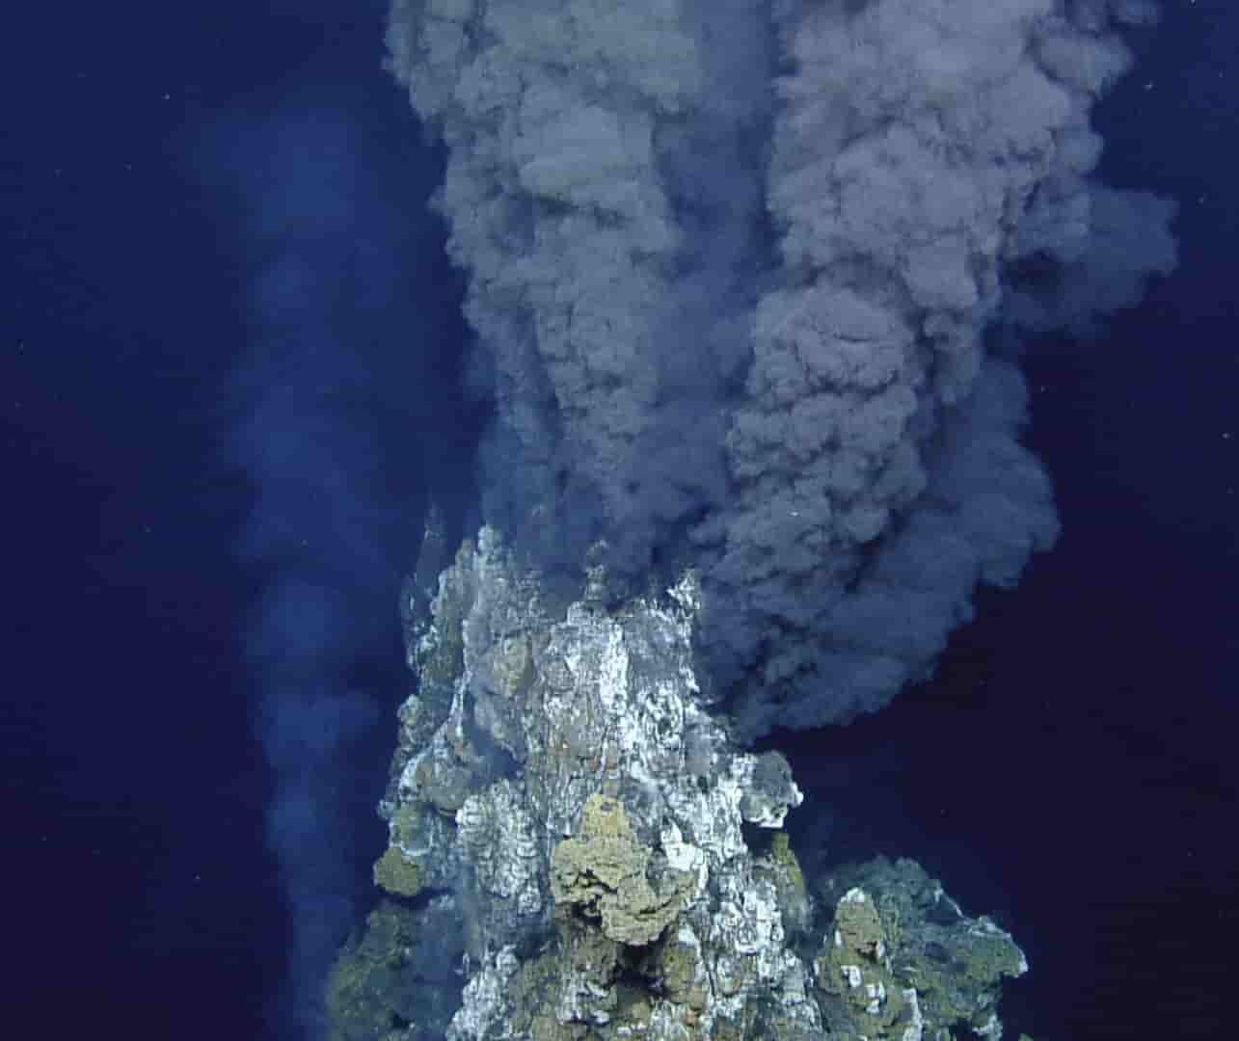
Ocean fronts (hydrothermal vents)
Source: Woods Hole Oceanographic Institution
Notes:
Hydrothermal vents are openings in the seafloor where geothermally heated water is released into the ocean. These vents are typically found near volcanically active places, areas where tectonic plates are moving apart, ocean basins, and hotspots.
Characteristics of Hydrothermal Vents:
Water at these vents can reach temperatures of over 400°C (752°F). Despite this extreme heat, the high pressure at these depths prevents the water from boiling.
Vents emit jets of mineral-rich water, which cool upon contact with ocean water, precipitating minerals that form distinctive chimney-like structures.
Unique Ecosystems:
Hydrothermal vents host unique ecosystems that do not rely on sunlight for energy. Instead, bacteria and archaea at these vents perform chemosynthesis, using vent chemicals like hydrogen sulfide to create organic material.
These bacteria are the base of the food web, supporting a diverse array of life, including giant tube worms, clams, and unique fish species.
Biological Research:
Vent organisms are adapted to extreme conditions, offering insights into the limits of life and informing the study of extremophiles. This research can help us understand life's potential on other celestial bodies, such as moons and planets where similar conditions may exist.
Mineral Deposits:
Hydrothermal vents are significant sources of minerals, including copper, gold, and other valuable metals. These deposits are formed from the precipitation of dissolved minerals in vent fluids.
Earth's Geochemical Cycles:
Vents play a crucial role in the geochemical cycling of sulfur, carbon, and other elements, affecting their distribution and abundance in the ocean.
Climate Change Insights:
Studying hydrothermal vents helps scientists understand past climate conditions through the analysis of isotopes and trace metals in vent deposits.

Slide 8
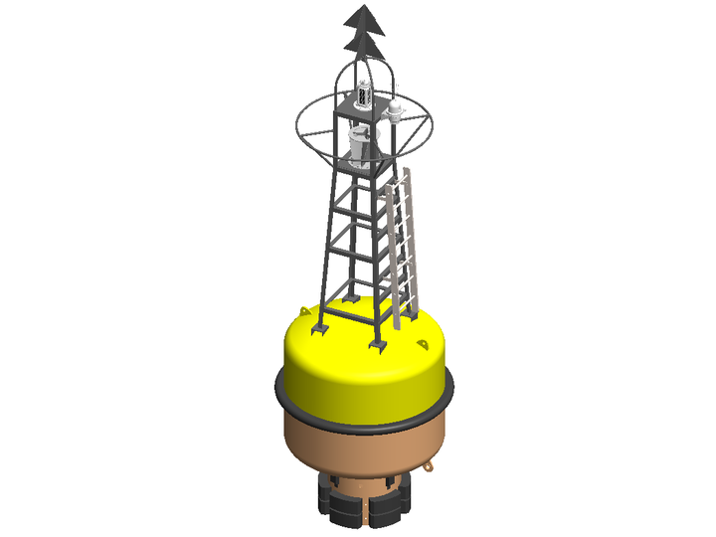
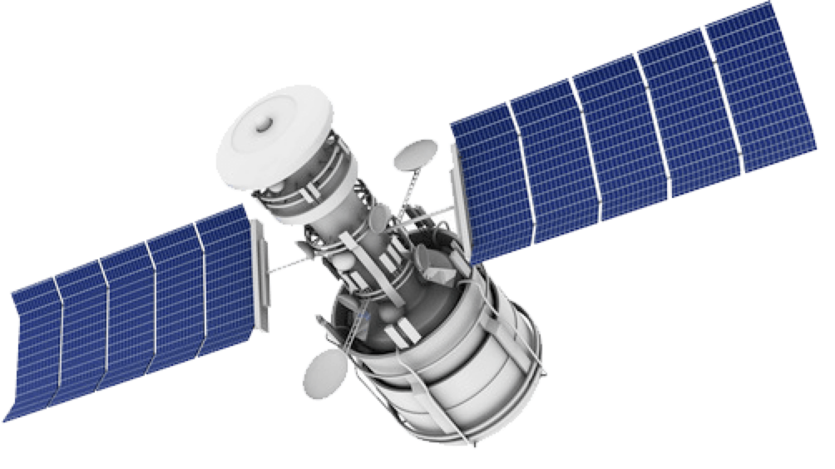
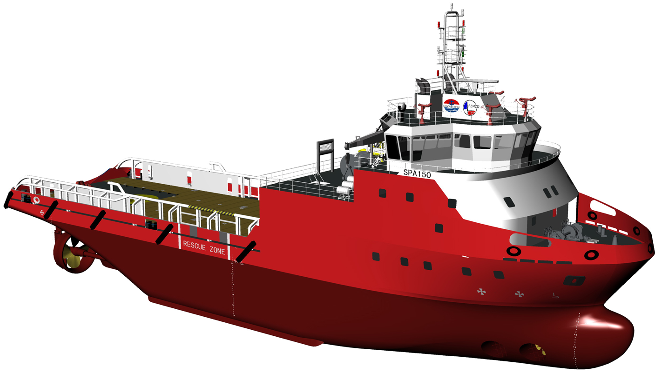
Ways of monitoring
Can provide large-scale view
Only limited on surface
Can carry many instruments
Expensive and limited by weather
Ideal for long-term monitoring
Not so flexible
Notes:
1. Satellite Imaging
Pros:
Global Coverage: Satellites can monitor vast areas of the Earth's surface, including remote and inaccessible regions, providing comprehensive global data coverage.
Continuous Monitoring: They offer the ability to continuously monitor oceanographic and atmospheric conditions over time, aiding in long-term climate studies and weather forecasting.
Cost Efficiency: Once in orbit, satellites can collect extensive data over broad areas with relatively low operational costs compared to in-situ methods.
Cons:
Resolution Limits: The spatial and temporal resolution can be limited compared to direct measurements, potentially missing finer details that are crucial for certain studies.
Indirect Measurement: Satellites measure properties indirectly through sensors and algorithms, which can introduce uncertainties and require ground-truth validation.
Weather Dependency: Imaging can be obstructed by cloud cover, affecting the consistency and reliability of data collection.
2. Ship Surveys
Pros:
Direct Measurements: Ships provide direct and high-accuracy measurements of oceanographic parameters such as water temperature, salinity, and depth.
Multidisciplinary Studies: They allow for multidisciplinary research (biological, chemical, physical) simultaneously, using a variety of equipment and methodologies.
Flexible Sampling: Researchers can adapt sampling strategies in real-time based on initial findings, allowing for responsive and dynamic research approaches.
Cons:
High Cost: Ship operations are costly, requiring significant fuel, crew, and maintenance expenses.
Limited Coverage: Ships can only cover limited areas compared to satellites, making global assessments challenging and time-consuming.
Weather and Sea Conditions: Rough sea conditions and poor weather can delay or cancel missions, limiting operational windows.
3. Static or Dynamic Buoys
Pros:
Continuous Local Data: Buoys provide continuous, real-time data for a specific location, offering detailed local monitoring of conditions.
Support for Calibration: They are essential for calibrating and validating satellite data, ensuring accuracy in remote sensing.
Versatility: Buoys can be equipped with various sensors to monitor different parameters, and dynamic buoys can move to different locations for broader coverage.
Cons:
Maintenance Needs: Buoys require regular maintenance and calibration, which can be challenging and expensive, especially in remote or harsh environments.
Data Gaps: If buoys fail or are lost due to harsh weather or accidents, this can lead to significant data gaps.
Deployment Limitations: The number of buoys that can be deployed is often limited by budget and logistical constraints, affecting the spatial resolution of data.

Slide 9
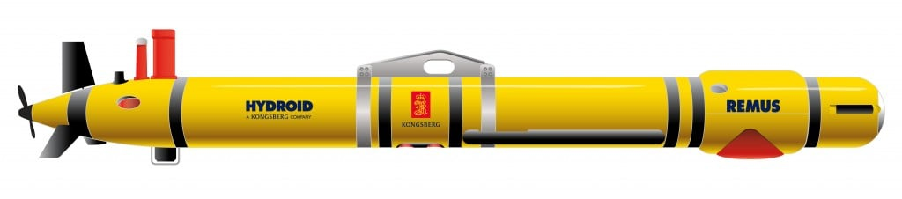
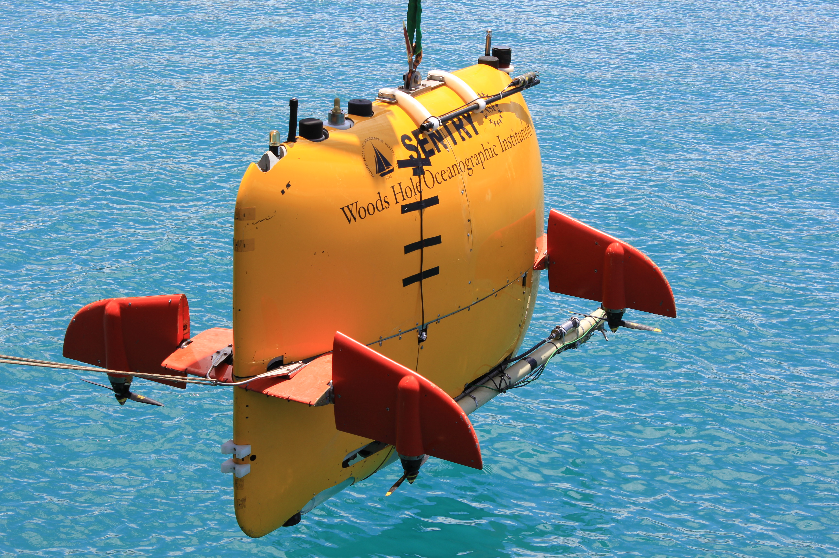
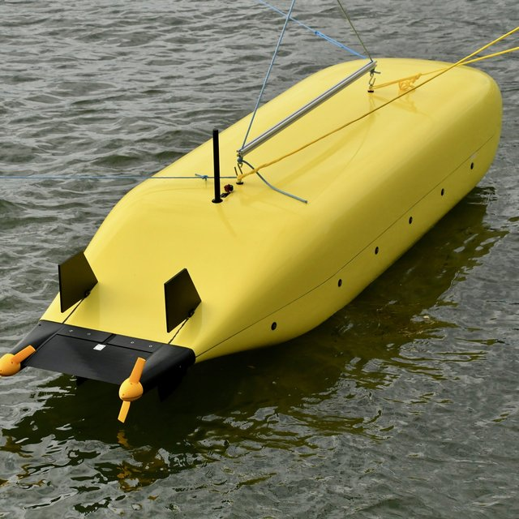
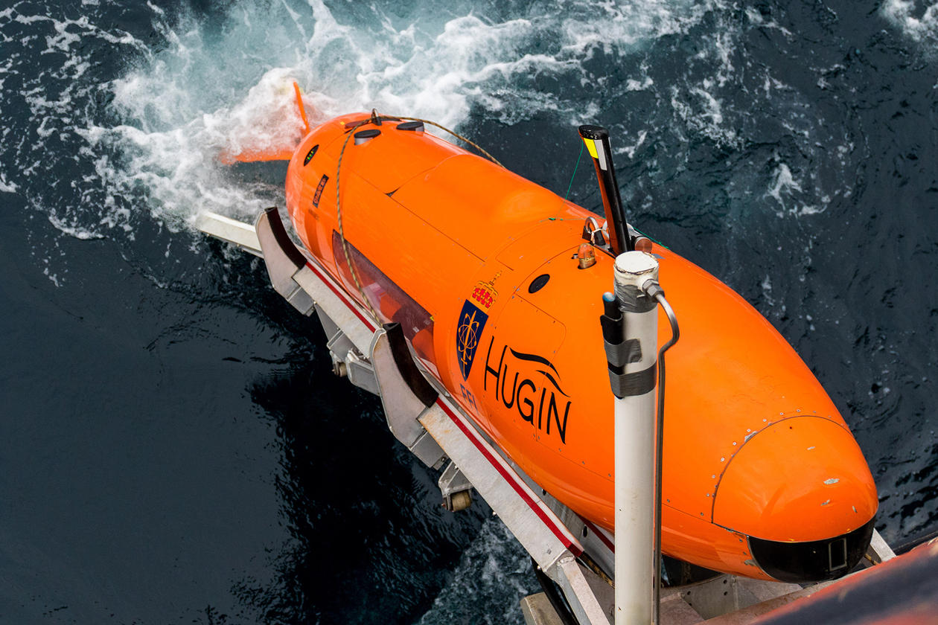
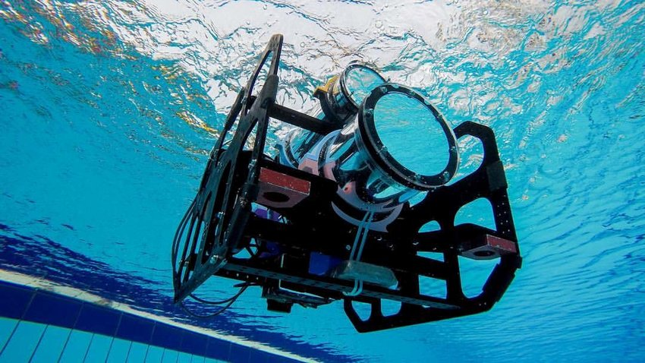
Autonomous Underwater Vehicles
What is AUV?
Why is it useful?
1
2
3
4
Notes:
Hugin can dive to 6000 meter for 100 hours
High Spatial and Temporal Resolution:
Autonomous Underwater Vehicles (AUVs) are robotic devices that travel underwater without requiring real-time input from human operators. These vehicles are pre-programmed with missions and can navigate through the water independently using onboard sensors and navigation systems.
Features of AUVs:
Equipped with various scientific instruments to collect data such as temperature, depth, salinity, and images of the seafloor.
Operate at various depths, from shallow waters to deep oceans, often reaching places inaccessible to humans.
Why AUVs Are Useful:
1. Scientific Research:
Deep-Sea Exploration: AUVs can explore the deep ocean, including areas around hydrothermal vents, deep-sea trenches, and underwater volcanoes, which are otherwise challenging and risky for humans to reach.
Environmental Monitoring: They are used for monitoring environmental conditions, studying water quality, and assessing the health of marine ecosystems.
2. Enhanced Data Collection:
High-Quality Data: AUVs collect high-resolution data that is crucial for detailed mapping of the ocean floor and studying marine habitats.
Repeated Surveys: Capable of conducting repeated missions over the same area to observe changes over time, providing valuable data for climate change research and monitoring.
3. Cost-Effectiveness:
Reduced Risk and Cost: They reduce the need for expensive and potentially risky manned submarine missions, lowering the cost and increasing safety.
Operational Efficiency: AUVs can operate in harsh weather conditions and over extended periods, improving data collection efficiency.
4. Commercial and Military Uses:
Underwater Infrastructure Inspection: AUVs inspect pipelines, cables, and other infrastructures, ensuring maintenance and safety in the commercial sector.
Surveillance: They are used in military applications for surveillance, mine countermeasures, and reconnaissance without exposing human divers to danger.
5. Search and Rescue Operations:
Wreckage Location: AUVs assist in locating submerged wreckage and are instrumental in search and recovery missions, leveraging their ability to rapidly cover large areas.

Slide 10
Why AUV?
High Spatial and Temporal Resolution
Adaptive Sampling Capabilities
Cost Efficiency
Access to Remote and Harsh Environments

Slide 11
Adaptive sampling
Definition
Dynamically adjusting the data collection strategy based on real-time data.
Optimizes resource use and improves data relevance.
Key features
Real-time Data Analysis
Dynamic Decision-Making
Efficient Resource Use
Advantages?
Efficiency
Complex environment suitability
Notes:
Definition of Adaptive Sampling:
Adaptive Sampling is a dynamic and responsive approach used in scientific research and data collection, where the sampling strategy can be adjusted in real-time based on the data being collected. This method is particularly useful in environments that are complex and rapidly changing, such as marine ecosystems.
Mechanisms of Adaptive Sampling:
Utilizes sensors and data analytics to continuously assess the environment and modify sampling protocols accordingly.
Often implemented using autonomous systems like Autonomous Underwater Vehicles (AUVs), drones, or robotic instruments that can change their behavior based on situational analysis.
Importance of Adaptive Sampling:
1. Enhanced Data Efficiency:
Targeted Data Collection: Focuses on areas or phenomena of interest, maximizing the value of data collected by concentrating on hotspots or significant events (e.g., algal blooms, pollution discharge).
Resource Efficiency: Reduces wasted effort and resources on less informative areas, optimizing the use of time and equipment.
2. Improved Environmental Monitoring:
Responsive Sampling: Quickly adapts to environmental changes, allowing for the capture of transient or critical events that might be missed by traditional fixed sampling methods.
Better Resolution of Data: Provides higher spatial and temporal resolution where and when it matters, enhancing the understanding of complex environmental dynamics.
3. Cost-Effectiveness:
Reduced Operational Costs: By focusing on key areas, adaptive sampling can reduce the overall time and cost associated with wide-area surveillance and large-scale data collection.
Minimizes Risk: Limits exposure of equipment and personnel in unpredictable or hazardous conditions by efficiently managing where and when to sample.
4. Applications in Various Fields:
Oceanography: Used to study dynamic ocean processes like current flows, temperature changes, and biological activity.
Environmental Science: Monitors pollution levels, tracks wildlife, and assesses habitat conditions adaptively to respond to immediate changes.
Agriculture: Manages crop health and soil conditions by adjusting sampling based on observed plant stress indicators or pest presence.

Slide 12
Challenges in oceanfront sampling
Environmental factors
Unpredictable currents and turbulence
Dynamic and complex environment
Technical challenges
Navigation and localization in underwater
Data transmission and coordination
Notes:
Definition of Ocean Front Sampling:
Ocean Front Sampling involves collecting data from ocean fronts, which are dynamic boundaries between different water masses characterized by variations in temperature, salinity, and other oceanographic parameters. These zones are critical for understanding marine ecosystems and climatic interactions.
Challenges in Ocean Front Sampling:
1. Dynamic Nature of Ocean Fronts:
High Variability: Ocean fronts are highly dynamic and can change location and characteristics rapidly due to wind, currents, and other environmental factors, making it difficult to predict their positions for sampling.
Temporal Changes: The transient nature of fronts means that timely data collection is crucial, as conditions can change significantly in a short period.
2. Harsh Environmental Conditions:
Weather and Sea State: Sampling at ocean fronts often involves working in adverse weather conditions and rough seas, which can pose risks to equipment and personnel.
Remote Locations: Many ocean fronts are located in remote parts of the ocean, far from coastlines, increasing the logistical challenges and costs associated with reaching these areas.
3. Technological Limitations:
Equipment Sensitivity: The precision required to measure the subtle differences across ocean fronts demands highly sensitive and sophisticated instruments, which can be prone to failure under harsh conditions.
Data Integration Issues: Integrating data from various sources (satellites, buoys, ships) to accurately characterize ocean fronts can be technically challenging due to differences in scale, resolution, and data formats.
4. Resource Intensity:
High Costs: The expense of deploying ships, crews, and advanced technology to remote ocean fronts can be substantial, limiting the frequency and duration of sampling campaigns.
Limited Accessibility: Accessibility issues, both in terms of geography and resource availability, can restrict the scope of research and long-term monitoring efforts.
5. Biological and Chemical Sampling:
Cross-contamination: Care must be taken to avoid contamination of samples, especially when tracing subtle biogeochemical processes that occur at ocean fronts.
Sample Preservation: Ensuring that biological and chemical samples are preserved adequately during collection and transport can be challenging but is crucial for accurate analysis.

Slide 13
Benefits of using multiple AUVs
Coordination and control strategies
Swarm intelligence and decentralized control
Pre-programmed routes vs. dynamic programming
Communication and Collaboration
Underwater communication
Real-time data sharing
Notes:
1. Enhanced Spatial Coverage:
Broad Area Monitoring: Multiple AUVs can cover extensive areas simultaneously, allowing for comprehensive mapping and monitoring of ocean fronts that are large and continuously changing.
Cross-Sectional Sampling: Deploying AUVs in parallel or distributed formations can effectively capture cross-sectional data of an ocean front, providing a three-dimensional perspective on the water mass boundaries.
2. Improved Data Resolution:
High-Resolution Data: The use of multiple AUVs increases the granularity of data collected, with overlapping routes that can capture finer details of the environmental gradients present at ocean fronts.
Temporal Frequency: Frequent, synchronized measurements by several AUVs can track rapid changes in the ocean front’s properties, aiding in the understanding of dynamic processes.
3. Redundancy and Reliability:
Backup Systems: Multiple AUVs ensure redundancy in data collection. If one vehicle fails or its data is compromised, others can fill in the gaps, ensuring continuity and reliability of the sampling mission.
Risk Distribution: Distributing the risk among several units minimizes the impact of any single point of failure, which is crucial in remote and harsh ocean environments.
4. Collaborative and Adaptive Sampling:
Inter-AUV Communication: AUVs can be equipped to communicate with each other, allowing for real-time data sharing and decision-making. This capability enables them to adapt their sampling strategies based on immediate findings from the group.
Layered Sampling Approaches: Different AUVs can be assigned specific roles, such as varying depths or focusing on different parameters, enhancing the adaptiveness and thoroughness of the sampling strategy.
5. Cost Efficiency and Safety:
Cost-Effective Operations: Using multiple AUVs can be more cost-effective over time compared to manned missions, especially in dangerous or inaccessible regions.
Enhanced Safety: Reduces the need for human presence in potentially hazardous ocean front environments, thereby increasing safety and reducing operational risks.

Slide 14
Case studies
Different control strategies
Different communication strategies
Different targeting strategies

Slide 15
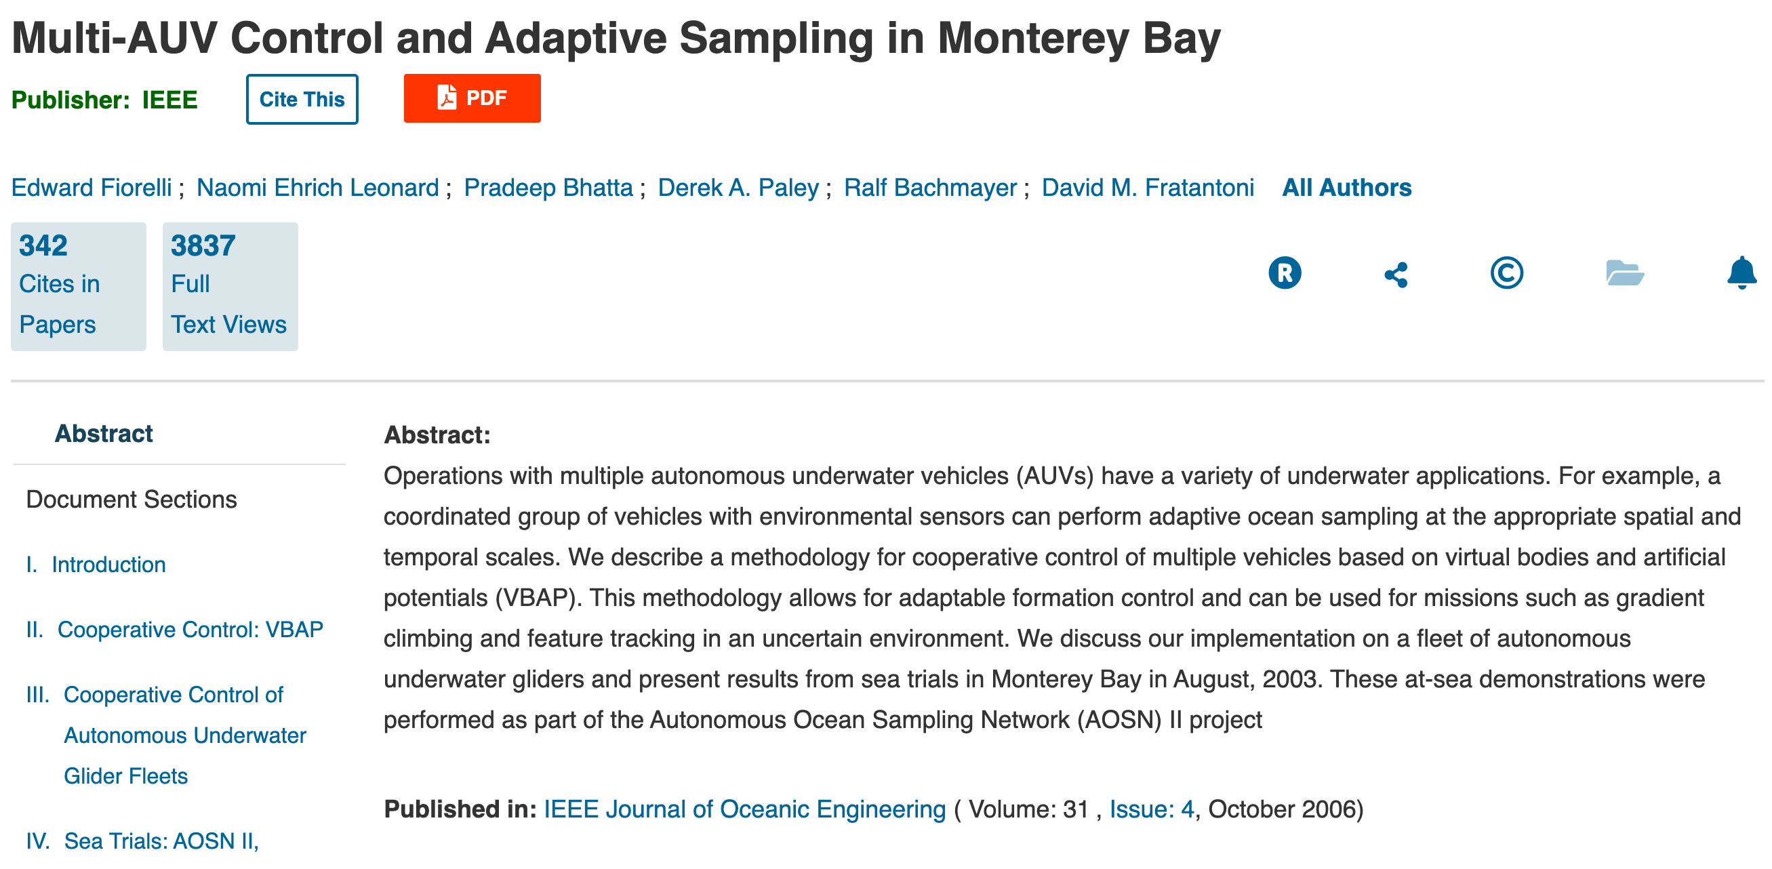
Case study I - Control of multi-AUVs

Slide 16
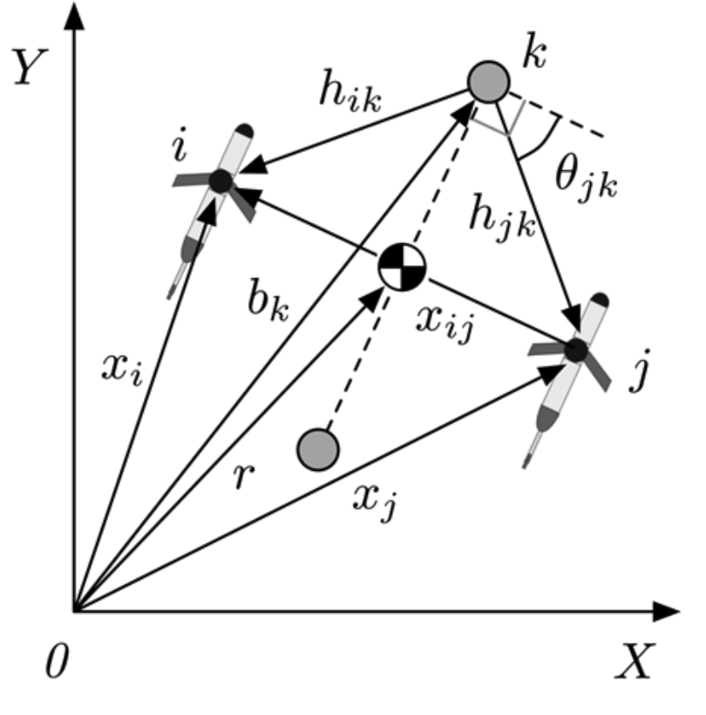
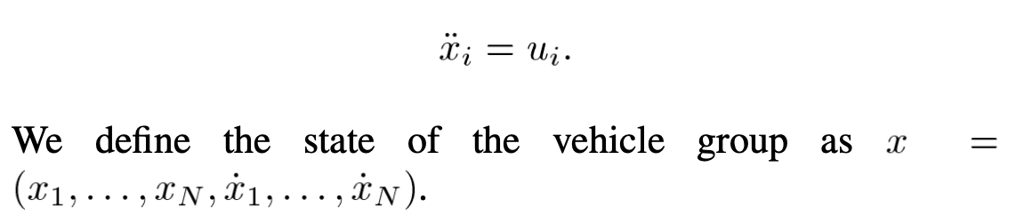
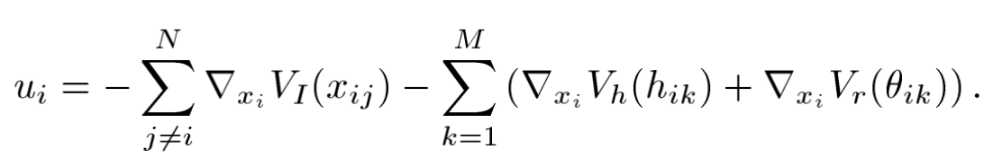
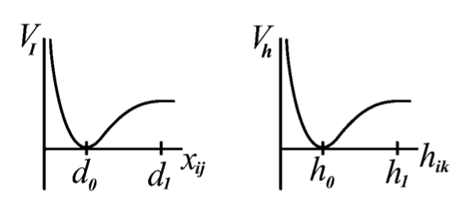
Case study I - VBAP

Slide 17
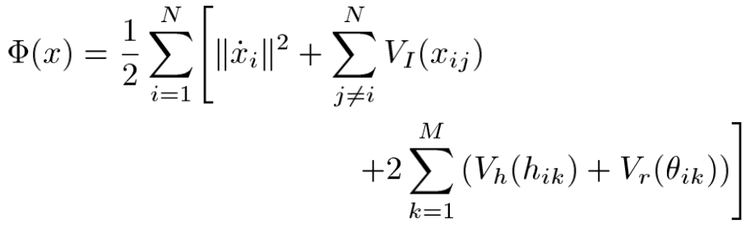
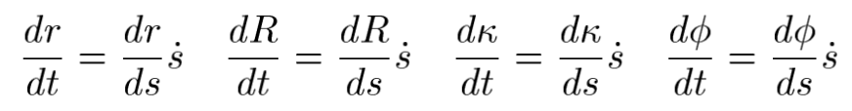
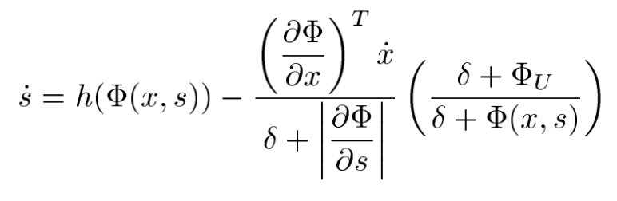
Case study I – Lyapunov function
Notes:
Formation error function,
r – position vector
R – orientation (angle of rotation in the plane)
k is scalar dilation factor
Phi – to fix additional degrees of freedom

Slide 18
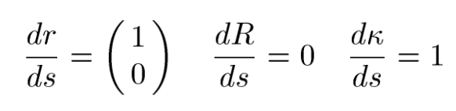
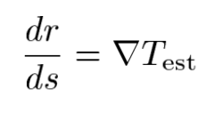
Case study I - Strategies
Stability and convergence of the formation
Feedback control based on the measurements
Notes:
1, expands over time, center moving in a straight line in the horizontal direction but its orientation is fixed, this is independent of chiose of group mission
2, each vehicle can measure any scalar environmental field T (temperature, salinity, biomass concentration).

Slide 19
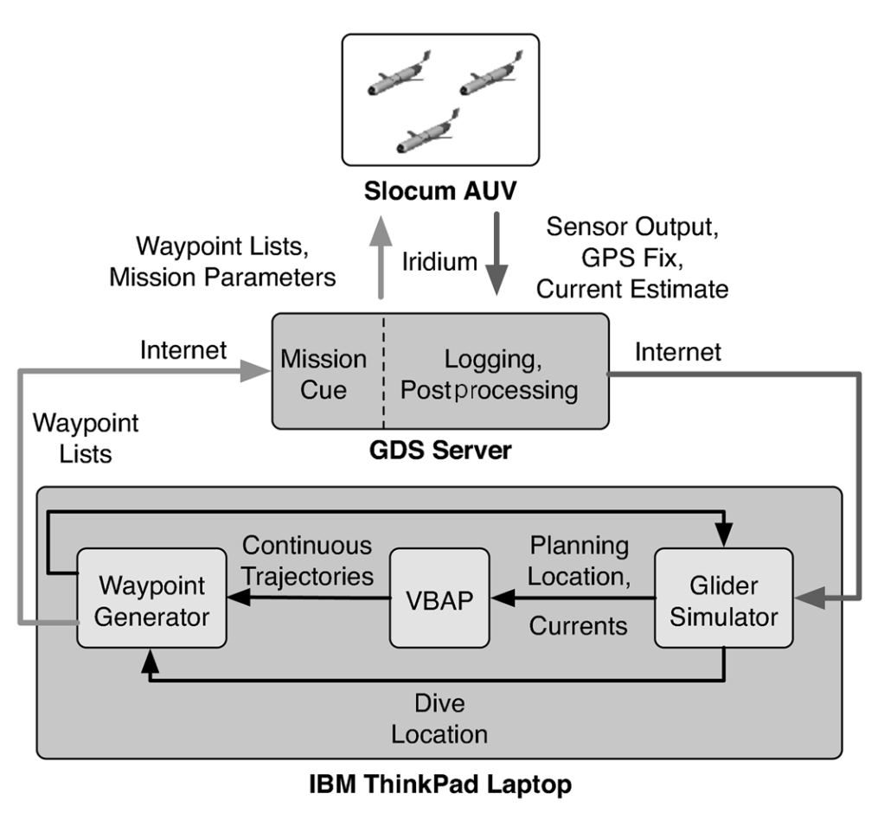
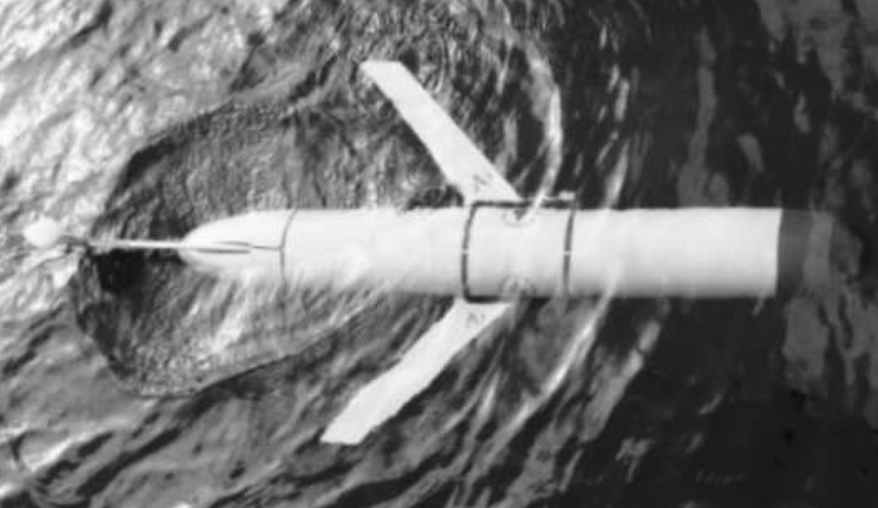
Case study I – Experiment setup
Slocum glider
Notes:
It can control the buoynacy to dive down to 100m
The current is estimated based on the GPS fix and its estimated state
No data transmission happening underwater

Slide 20
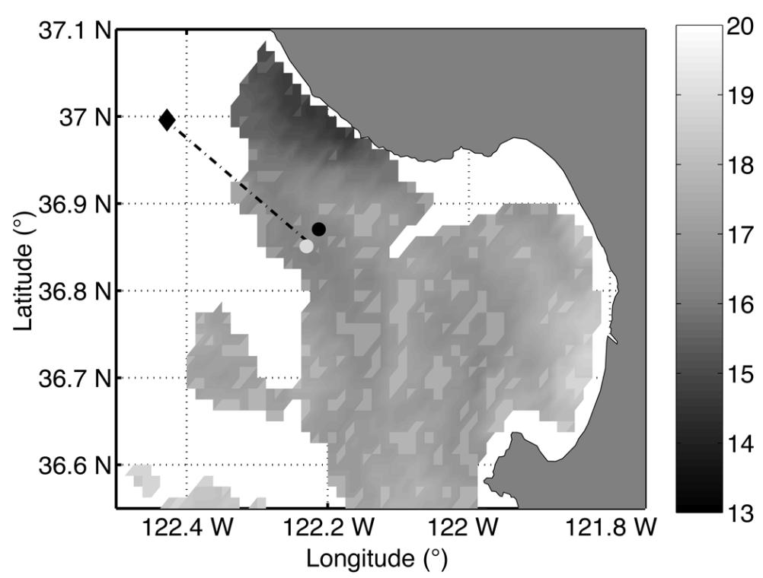
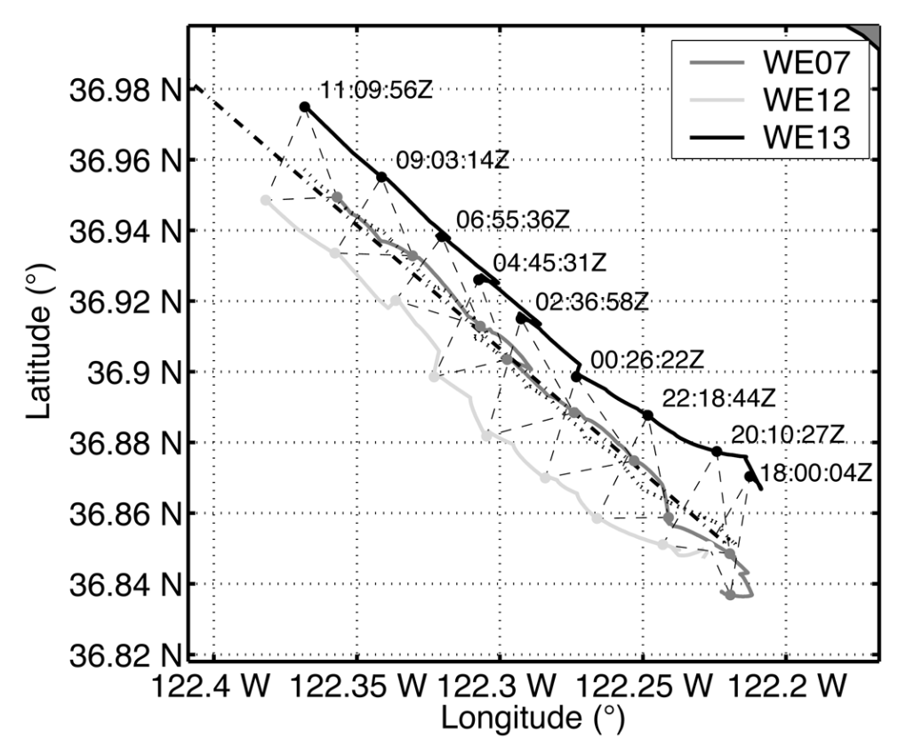
Case study I - Experiment
Glider formation at Upwelling event.

Slide 21
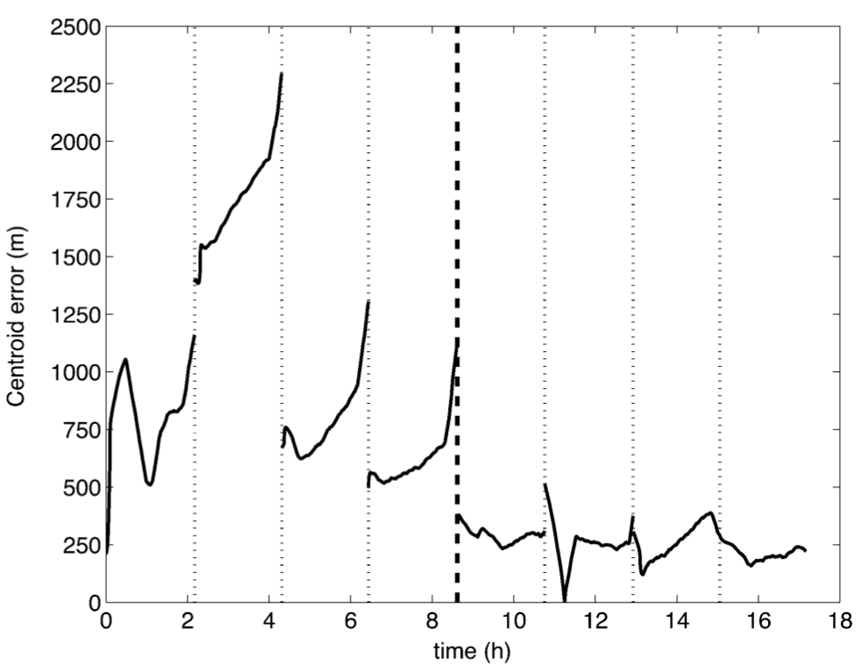
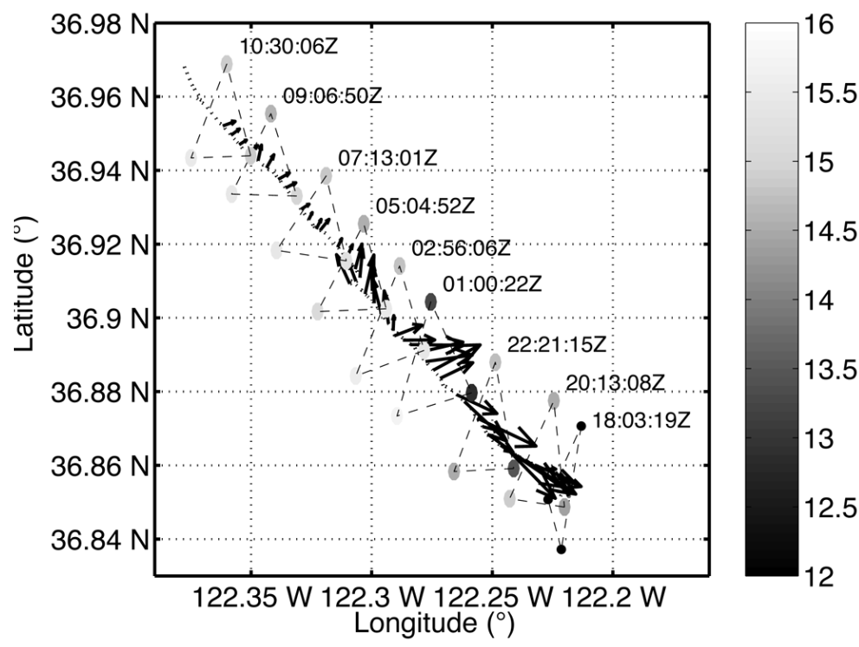
Case study I - Result analysis

Slide 22
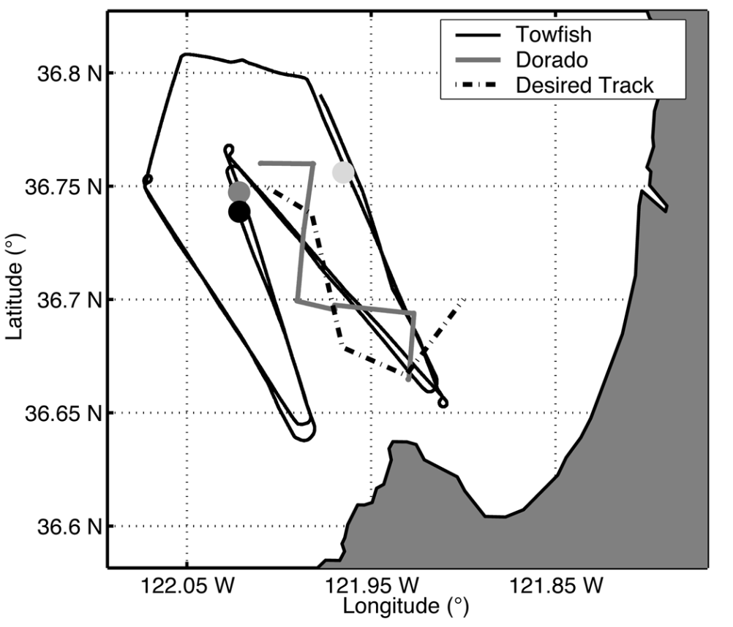
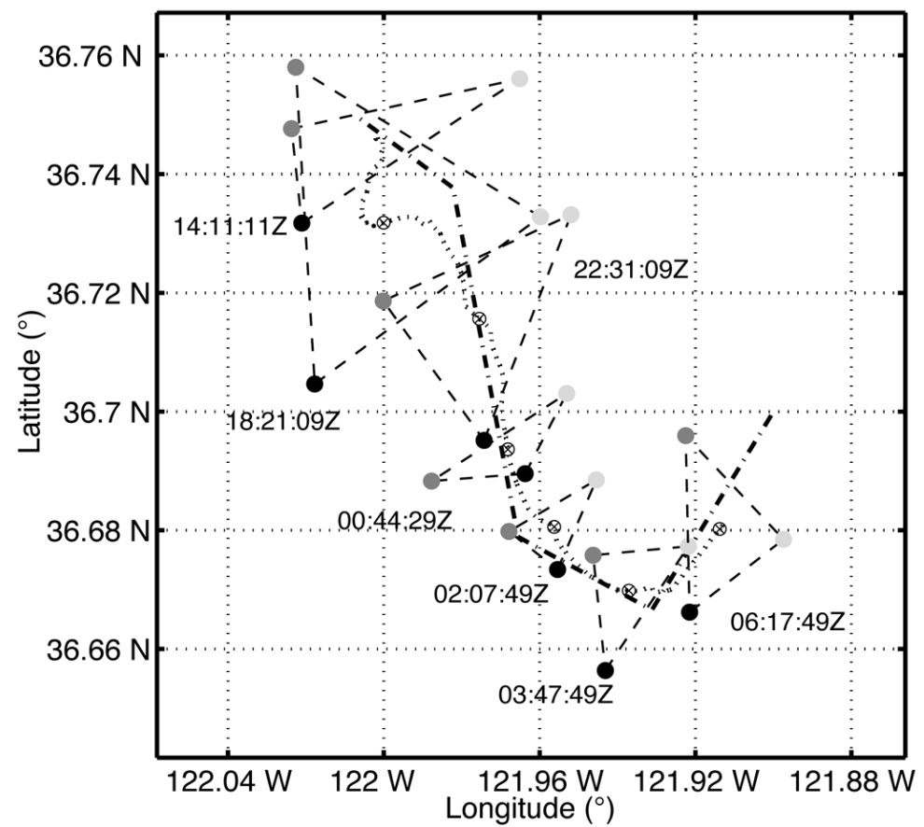
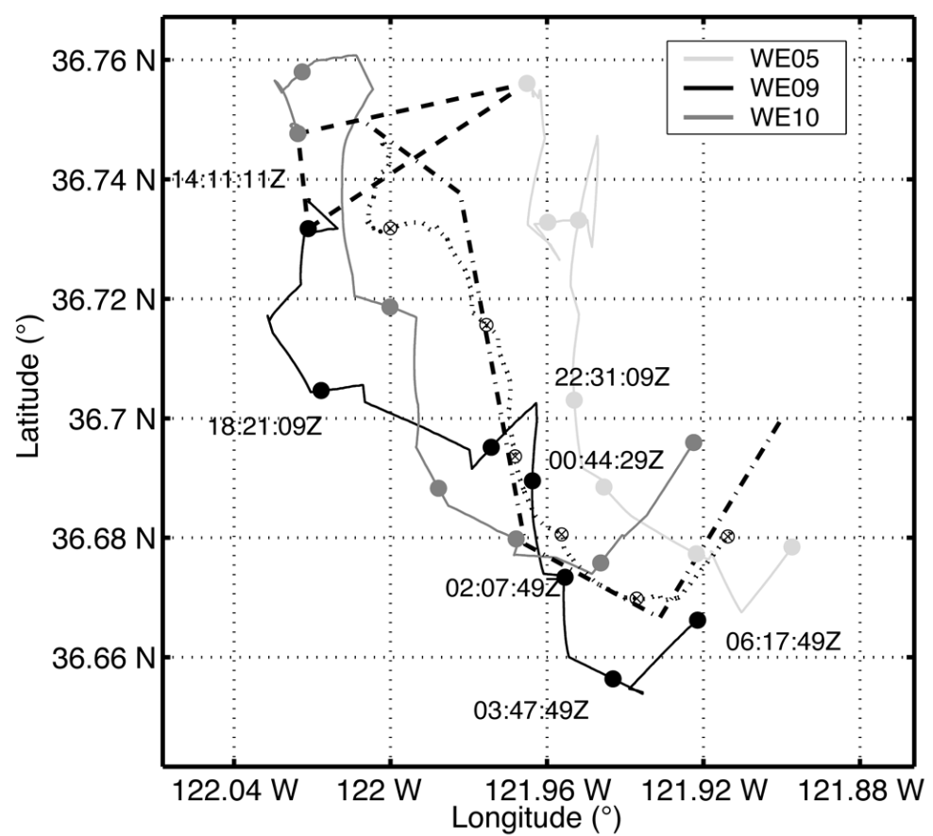
Case study I - Experiment
Multiasset demonstration

Slide 23
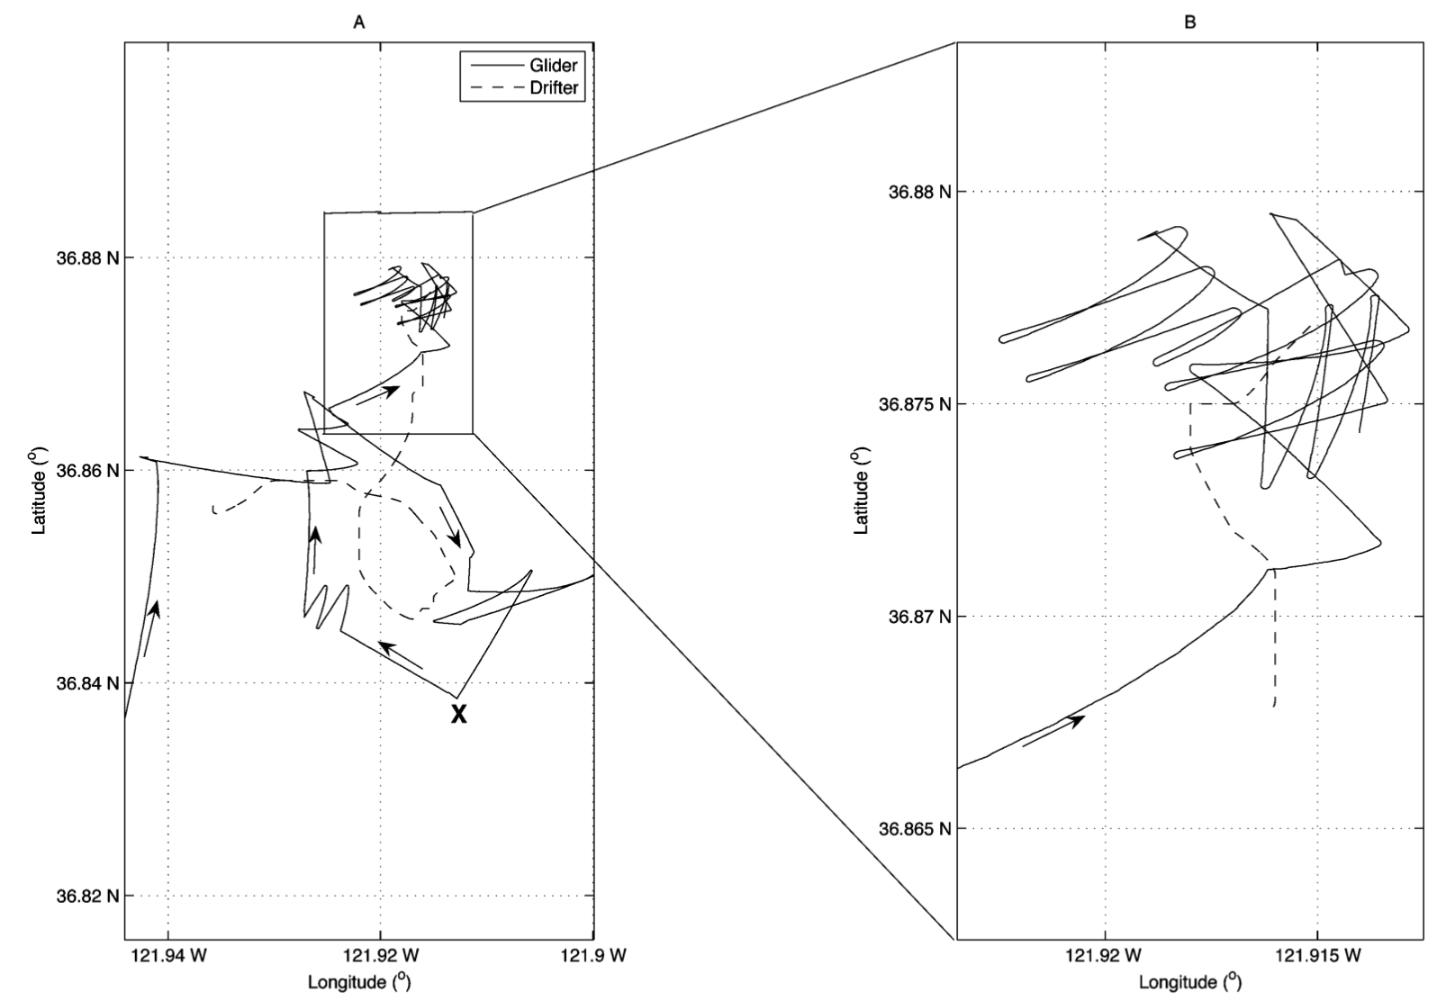
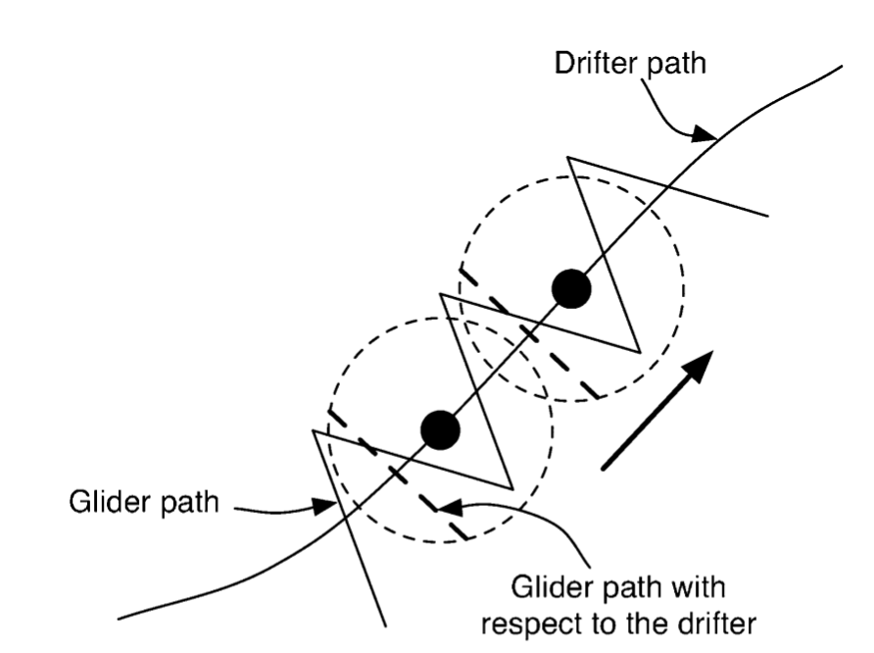
Case study I - Experiment
Drifter tracking

Slide 24
Case study I - Remarks
VBAP is proven to be effective in controlling multiple AUVs
Sea trials in Monterey Bay demonstrated that VBAP could main formations, manage orientations, and control inter-vehicle spacing with reasonable accuracy
VBAP enables adaptive sampling for gradient climbing and feature tracking
Future work could focus on the tidal effects and varying currents effects.

Slide 25
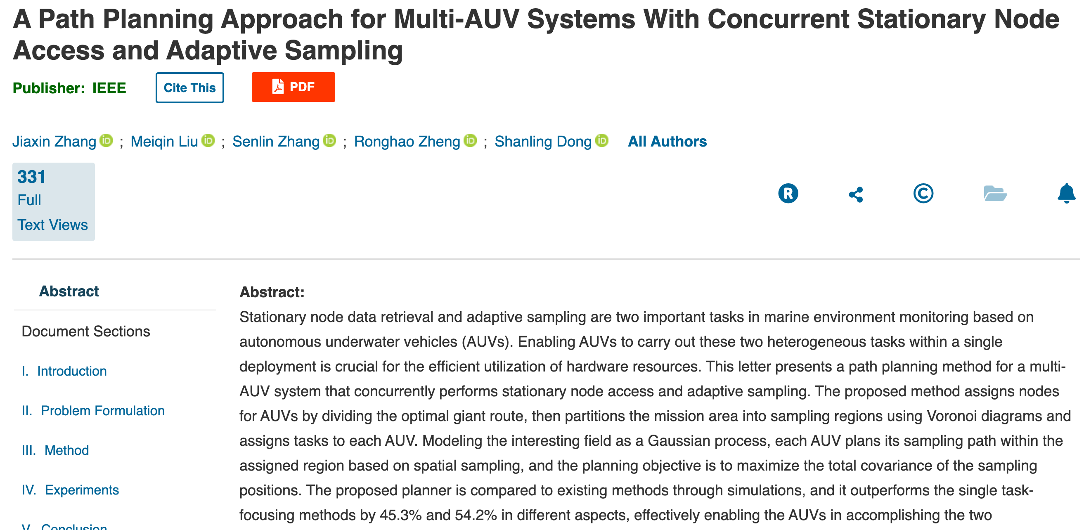
Case study II
Notes:
Published March 2024

Slide 26
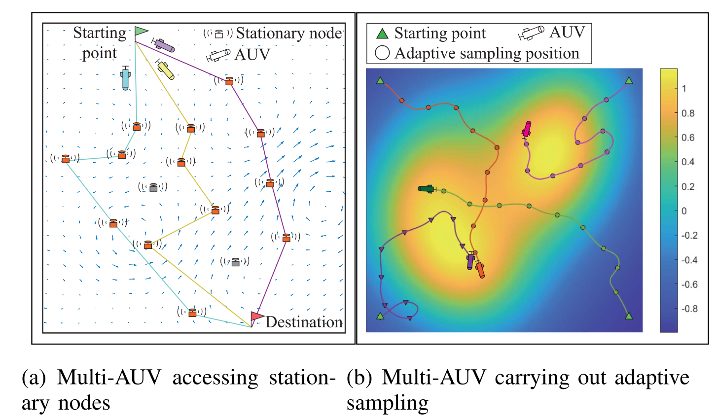
Case study II - Problem statement

Slide 27
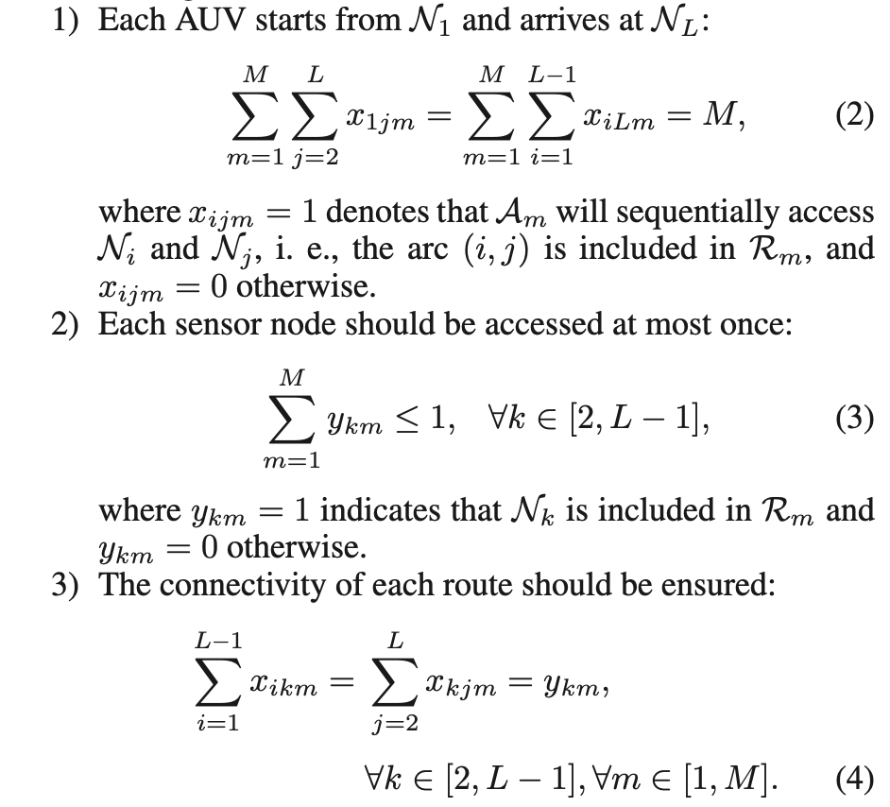
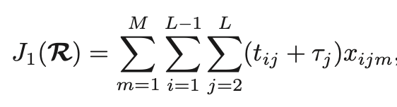
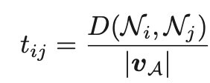
Case study II
Notes:
Tij: travel time
Tau – time spent to access that node

Slide 28
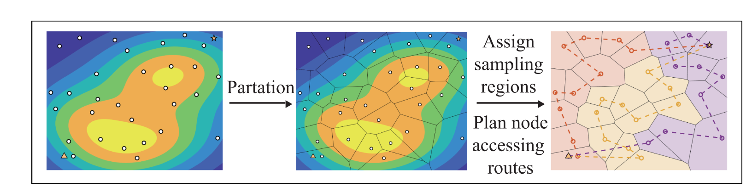
Case study II - Partitioning
Notes:
Generate a global partitioning first, then calculate the shortest path for one AUV, and then in the end, use GA to divide this giant route into small divisiions for more AUVs if applicable

Slide 29
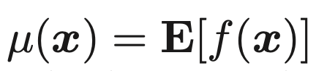
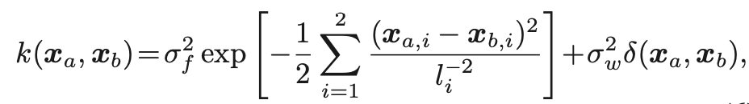
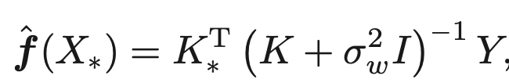
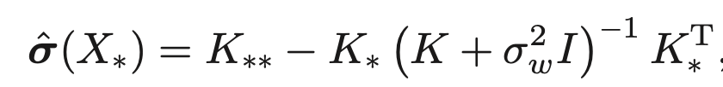
Case study II - Adaptive sampling
Gaussian Process for field kriging

Slide 30
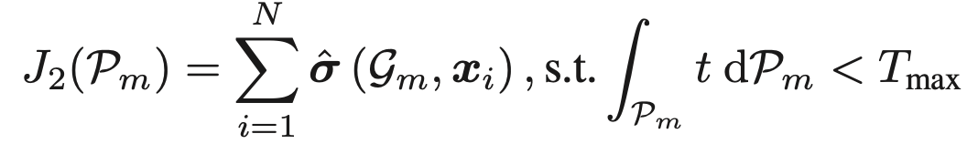

Case study II - Strategy

Slide 31


Case study II - Sampling

Slide 32

Case study II - Algorithm

Slide 33

Case study II - Simulation

Slide 34

Case study II - Benchmark
Notes:
FTRP: five tier route planner
ASPP: adaptive sampling path planner

Slide 35

Case study II - Simulation result

Slide 36

Case study II - Experiment setup

Slide 37

Case study II - Experiment result

Slide 38

Case study III
Lateral gradient detection
Upwelling front detection

Slide 39

Case study III

Slide 40

Case study III

Slide 41



Case study III - upwelling front detection
Notes:
Vertical temperature homogeneity index
AUV moving either from upwelling into stratiofied or vice versa

Slide 42

Case study III - historic data analysis
Notes:
To compare two methods: VTHI and lateral gradient, history data from May 1, 2017 is used
Warm, fresh to the west, cold salty to the east
Clearly a large gradient has been observed

Slide 43

Case study III - metric comparison

Slide 44



Slide 45


Slide 46
Future work
Improvements in AUV hardware and software
Enhanced communication and sensing capabilities
Machine learning for better adaptive sampling
Integrating big data sources such as AIS, satellite, buoys etc.

Slide 47
Conclusion
Oceanfronts are important for us
AUVs are flexibles to solve this problem
More AUV can help in certain ways, but its associated technical difficulty can be daunting to scale for now
AI can be a potential game changer

